Slide 1
Open Source
Module 2

Slide 2
Module Objectives
After this module, participants will be able to:
Understand the benefits of Open Source Software for Business and Enterprise
Enumerate the ways in which various open-source licenses can affect their usability.
See how open standards and RESTful web interfaces have transformed enterprise applciations.
.
.
Notes:
Instructor Notes:
Please let students know that in addition to the objectives they identified for themselves in taking this course, these are the ones we expect to achieve based on the material provided.
Participant Notes:
In addition to the objectives you identified in taking this course, these are the ones we expect to achieve based on the material provided.

Slide 3
Introduction to Open Source

Slide 4

Open Source Software
Open-source software (OSS) has the following properties:
It includes the source code.
Released under a license in which the copyright holder grants users the rights to study, change, and distribute the software to anyone and for any purpose
Provides rights to change and distribute the code.
Usually, OSS is developed in a distributed, collaborative manner.
Notes:
Instructor Notes:
Ask students to name a few OSS products they use
Participant Notes:
https://en.wikipedia.org/wiki/Open-source_software
Open source software as a movement started in 1998 after Netscape release their source code for public use. But free software started even earlier, in the 1980’s, with Richard Stallman writing the GNU license.

Slide 5



Early Software Sharing
Early computer companies sold software:
Software was included with the hardware
Companies did not sell separately
Source code was often included with the purchase
Academic Model of Sharing:
Most software in the public domain (PD)
ARPANET facilitated sharing
1974 Court decision: Software is copyrightable as a literary work
Notes:
Instructor notes:
Instructor Notes are the same as Participant Notes.
Please present the Participant Notes.
Participant Notes:
Public Domain indicates that the software is free to be used by anyone.
Software that is developed using tax payer money is often placed in public domain.
There are works of art that are in public domain (e.g., 'Alice in Wonderland' novel).

Slide 6
Proprietary Software
1969: IBM charges separately for mainframe software
1976: Bill Gates urges hobbyists to stop copying software
1980s-1990s:
Most software proprietary and closed-source
1992: Apple vs. Franklin
1993: IBM ships mainframe software object/binary only
Franklin copied parts of Apple’s binary OS
Court decided that binary code is also copyrightable
Notes:
Instructor notes:
Instructor Notes are the same as Participant Notes.
Please present the Participant Notes.
Participant Notes:
Initially, software was considered an addendum to the hardware, something, without which the hardware could not be sold. It had a list price but often it was discounted to $0 and just added in with the hardware sale.
Incidentally, developers were considered a loss center, because of this.
There was little incentive to copy software because it was specific to the hardware.
All this changed through the years, of course, as can be seen from this slide.

Slide 7
Emergence of Free Software
1982: Free Software Foundation, Richard Stallman
What is “free” software?
GNU (“GNUs not Unix”)
Advocated for "Free" Software
Created software for UNIX that was "free"
Not necessarily free of cost (gratis), "free beer"
Free as in "freedom" (libre) ("Free Speech")
Doesn't restrict the user from using the software as he/she sees fit.
Stallman started to create a "free" UNIX variant called GNU.
Eventually, it became part of the Linux ecosystem.
Invented GNU Public License (GPL) -- more on this later.
Notes:
Instructor notes:
Instructor Notes are the same as Participant Notes.
Please present the Participant Notes.
Participant Notes:
As you can see, free software was an invention and a social movement. It was a revolutionary idea, partially a reaction to the commercial software success, habits, and methods of operation.

Slide 8
Early History of Open Source
1983: GNU
1990s: Internet makes Free Software popular
2000s:
Open Source is mainstream
1991: Linux
Late 1997: Cathedral and Bazaar
Linux really accelerates free software
Commercial enterprises embrace open source
Notes:
Instructor notes:
Instructor Notes are the same as Participant Notes.
Please present the Participant Notes.
Participant Notes:
This timeline illustrates important milestones in Open Source.
We will discuss each period in detail in the upcoming slides.
Reference
- https://en.wikipedia.org/wiki/History_of_free_and_open-source_software

Slide 9
Freeware, Public Domain, and Shareware
Freeware
Public Domain (PD)
Shareware
"Freeware" is software that is without cost to the user
i.e., "gratis" or "free beer"
A lot of proprietary software is free of cost.
Adobe Flash / Adobe Reader
Mobile Apps
"Freeware" not necessarily "Free" as in "libre"
Much early software was Public Domain (PD)
Means not copyrighted, owned by public
Technically needs a statement waiving copyright (Disclaimer)
Problem: Companies afraid to use PD
"Who owns it? How do I know I have a right to use it?"
Software for which "copying" and "sharing" is encouraged
Usually copyrighted though not sold
Not necessarily "free" or "open source"
Trialware, Adware, CrippleWare, DonationWare
Example: PKZIP file archiving (.ZIP) - Requested $25.00
Notes:
Instructor notes:
Instructor Notes are the same as Participant Notes.
Please present the Participant Notes.
Participant Notes:
Do not confuse 'free' and 'open’. There is a substantial difference.
Free simply means that you don’t have to pay for the software, but says nothing about the nature of it.
Open means that anybody can read and usually use the source. But the specific conditions are usually set in the accompanying license.
The Internet enabled shareware – because now the developers had a much easier way to distribute the program to end users.
Initially, there was little awareness and a lot of confusion regarding the licensing for this type of software.

Slide 10
Open Source
"Free Software" perceived as anti-commercial
Stallman criticized for leftist advocacy
Not friendly with corporate interests
"Open Source" reframed the issue
Emphasized benefits to companies of having open-source
Eric Raymond: "The Cathedral and the Bazaar"
Emphasized benefits to companies
Notes:
Instructor notes:
Instructor Notes are the same as Participant Notes.
Please present the Participant Notes.
Participant Notes:
As you can see, open source software went through many upheavals. Steve Ballmer used to call it “communist cancer.”
For further reading, see http://www.catb.org/esr/writings/cathedral-bazaar/

Slide 11
Cathedral and The Bazaar
Eric Raymond Published "The Cathedral and the Bazaar"
Proprietary Software like a Cathedral:
Top down
Centralized
Slow
Bug-prone
Open Source Development like Bazaar:
Bottom up
Distributed
Self-correcting
Notes:
Instructor notes:
Instructor Notes are the same as Participant Notes.
Please present the Participant Notes.
Participant Notes:
Eric Raymond, together with Richard Stallman, contributed to the social acceptance of open source software.
Image used under Creative Commons License from: https://commons.wikimedia.org/wiki/File:Eric_S_Raymond_portrait.jpg

Slide 12

Linux
1991: Linus Torvalds released Unix-like kernel
Used a "freeware" type license for noncommercial purposes
1992: Re-released under GNU GPL
Intended to be used with GNU project software
Linux or GNU/Linux?
Strictly speaking, only kernel is "Linux"
Practically, most refer to whole system as Linux
Linux (or GNU/Linux) first main OSS project in the industry
Notes:
Instructor notes:
Instructor Notes are the same as Participant Notes.
Please present the Participant Notes.
Participant Notes:
Linus Torvalds used Unix at the university and could not understand why it was not available easily at his work. Windows he found far inferior. He tried to rewrite Linux on his own, and after six months of work, he still had essentially nothing. Then he came up with the brilliant idea of making it a community project.
Linus also proved efficient at organizing people and at managing project. In fact, Linus is quite brilliant – see the next slide.

Slide 13
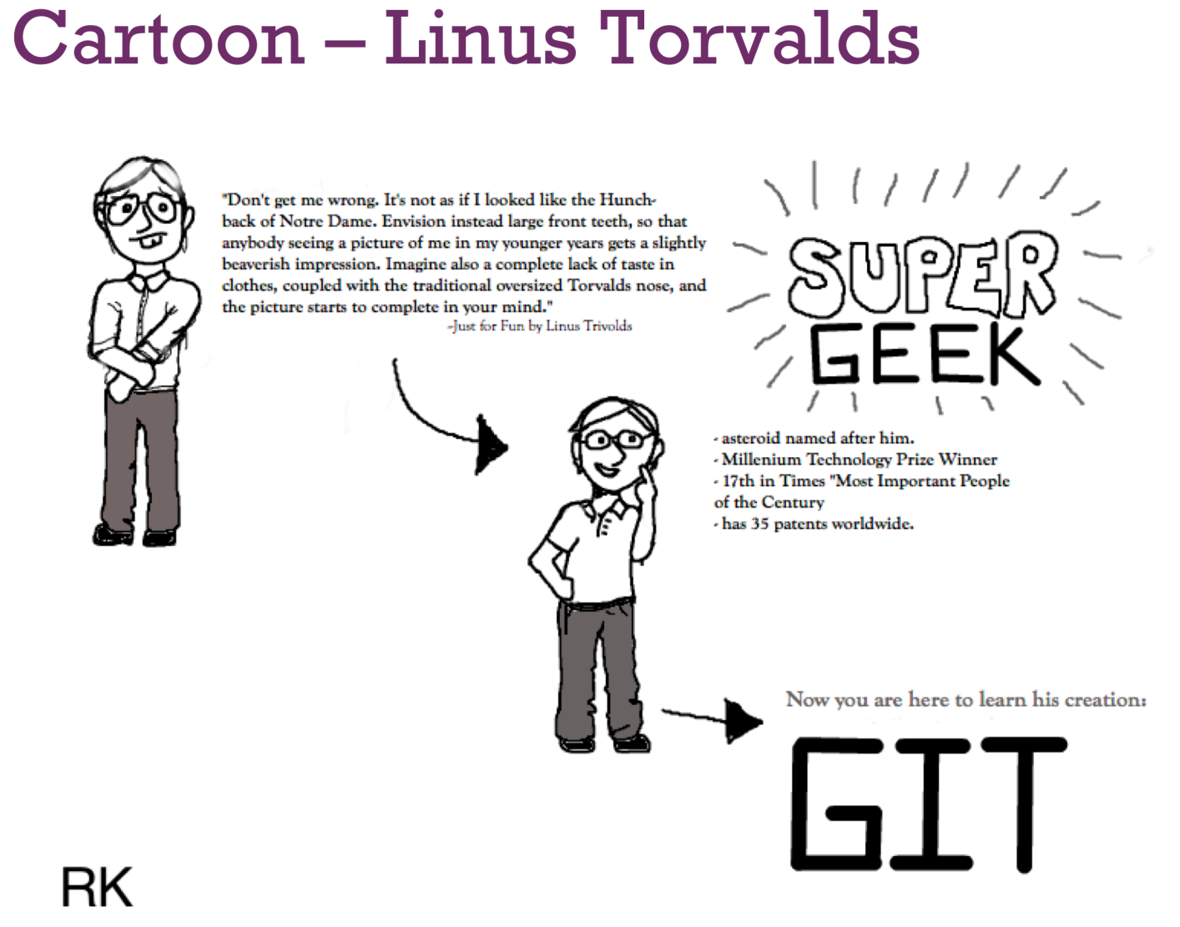
Interesting Facts about Linus Torvalds
Notes:
Instructor Notes:
Instructor can add from their knowledge of anecdotes about Linus Torvals and his Linux project.
Participant Notes:
Cartoon copyright Elephant Scale.

Slide 14

Netscape Story
Netscape was an early leader in "browser wars"
Created browser in 1994 as proprietary software
Proprietary software (non-free as in "speech")
Free of cost for noncommercial use, but companies had to license
Internet Explorer
Bundled with Windows at no extra charge
Quickly gained market share at Netscape's expense
Open Sourcing
Netscape announced it would "open source" product
First major corporation releasing product as OSS
Notes:
Instructor notes:
Instructor Notes are the same as Participant Notes.
Please present the Participant Notes.
Participant Notes:
Netscape also represents an interesting lesson in litigation, and specifically in eDiscovery. Now, eDiscovery is a task of parsing through all of the data in every imaginable format and in making that available for legal review. The lawyers then produce the documents to the other side.
Netscape claimed that Microsoft sought to destroy Netscape by leveraging its OS monopoly with Windows. Microsoft denied that. In eDiscovery, they found an email from Bill Gates that said plainly, “We must sink Netscape by any means.” This was what is called a smoking gun.
But why was Microsoft so bent on destroying Netscape? They correctly saw that the world was going to cloud and browser-based use. So then it meant the end of Windows dominance. Everyone knows the end of the story, so we don’t have to tell it here.

Slide 15
Recent History of Open Source
2000
2005:
Git is created
2006:
Hadoop
2008:
Github
We are here
Dot com bust incentivizes companies to adopt free open source software over proprietary software.
Github popularizes “social coding.”
Makes contributing to open source easier.
Notes:
Instructor notes:
Instructor Notes are the same as Participant Notes.
Please present the Participant Notes.
Participant Notes:
This timeline illustrates important milestones in Open Source.
We will discuss each period in detail in the upcoming slides.
Reference
- https://en.wikipedia.org/wiki/History_of_free_and_open-source_software

Slide 16


Open Source and Business
Many companies saw open-source as friendly to business
Example: IBM
Example: RedHat
IBMs main revenue was and still is services, not software
Open Source helps sell their services
RedHat sold Linux, which is free and Open Source
Companies are willing to pay for support, services
“Bottled Water Model": Water is "free", but customers will pay
Notes:
Instructor notes:
Instructor Notes are the same as Participant Notes.
Please present the Participant Notes.
Participant Notes:
However, keep in mind that RedHat was unique and that there is a common point of view that “There will never be another RedHat.”

Slide 17
Three Things That Made Open Source a Force!
GNU
Linux
Git and GitHub
GNU started to provide 'free' alternative to Unix system.
It lacked a kernel.
Linux kernel was the missing piece for GNU.
With Linux and GNU software there was a system powered by free, open source software that is usable.
Linux becomes very popular, powers the Internet after dot-com bust.
It also provides a thriving ecosystem for open source software development.
GitHub made:
Hosting
Maintaining
Collaborating
Open source projects easier.
Notes:
Instructor Notes:
Ask students if any of them contributed to open source projects on Github.
Participant Notes:
In June 2018, GitHub was acquired by Microsoft 7.5B in stock. This shows the importance of open source and of the changing culture at Microsoft.

Slide 18
Software Licenses

Slide 19
Licenses, Free Licenses, and GNU GPL
Licenses
Free Licenses
GNU General Public License
All Copyrighted software is owned by "someone"
Creator
Company
Nonprofit
PD Software is not owned by anyone
Have to "specifically" disclaim copyright
Otherwise copyright is implied, and license terms unknown
Copyrighted software must be licensed to the user
Companies develop EULA (End User License Agreement)
Using software implies the user has accepted terms
Sometimes "Click-through" or "Shrinkwrap" acceptance
"Free Software" decided against PD status for GNU
Retaining the copyright allows protection
"CopyLeft": Restricting distribution
Means the end user cannot include code in end-product
Not Commercially Friendly?
Companies can't use copylefted code in non-free products
GNU GPL is a "copyleft" license
Means that any "derivative" work must also be GPL
“Viral" aspect of the license
GPL'ed code cannot be sublicensed
GPL'ed code can only be used in a GPL'ed application
Steve Ballmer: "A Cancer", "A Virus", "Pac-Man Like"
Considered Corporate Unfriendly
Though most companies use some GPL software (Linux)
Notes:
Instructor notes:
Instructor Notes are the same as Participant Notes.
Please present the Participant Notes.
Participant Notes:
Licenses: There are companies that verify your use of free and open source software, like Black Duck, https://www.blackducksoftware.com/
Free licenses: We should mention that there are free code scanners and commercial companies, like Black Duck Software, that find out about potential licensing problem. This slide particularly illustrates the seriousness of this: you may have to open source software that you have built on top of GNU software.
GNU General Public License: For further study, you can use the following guide: https://www.gnu.org/licenses/quick-guide-gplv3.en.html

Slide 20

GPL Versions
GPLv2 vs GPLv3
GPLv3 has some additional requirements:
Requires all owned patents required to run software be licensed
Limits the Usage of DRM (Digital Rights Management)
Allows more compatibility with other licenses (Apache)
Linux still licensed under GPL v2
Notes:
Instructor notes:
Instructor Notes are the same as Participant Notes.
Please present the Participant Notes.
Participant Notes:
The fight between GPL2 and GPL3 license was long and acrimonious. It happened because software patents came into the light. There are patent trolls today, and there are practicing entities. There are lawsuits (often in East Texas where the judges are famously inclined in favor of the plaintiffs), which can stop even Apple in its tracks. Thus, these questions are real and important.

Slide 21
GNU LGPL
GPL requires "derivative works" to also be GPL.
But what about libraries?
Can you use a GPL'ed library in your code?
Static linking is explicitly forbidden for GPL.
Dynamic linking not entirely clear.
GNU LGPL (Lesser GPL) allows linking explicitly.
Static and Dynamic linking.
"Copy and Paste" Code is not allowed.
Notes:
Instructor notes:
Instructor Notes are the same as Participant Notes.
Please present the Participant Notes.
Participant Notes:
LGPL is thus a combination of the open source ideals and business friendliness. However, many developers simple opt for Apache 2 license, which has all of the user friendliness and none of the GNU GPL baggage or associations.

Slide 22
Permissive Licenses
BSD Unix (Berkeley System Distribution)
BSD Unix was originally non-free
Relicensed under permissive license (BSD)
Free but not "copylefted"
Originally contained an "advertising clause" -- but later removed
MIT License
More popular today with OSS projects than BSD
Similarly permissive
Permissive Licenses allow "Copy and paste"
Companies can use code in proprietary products
Example: Apple uses BSD Linux (free) in Mac OS (Not free)
May require attribution of code use in final product
Allows companies to have free and non-free versions
Notes:
Instructor notes:
Instructor Notes are the same as Participant Notes.
Please present the Participant Notes.
Participant Notes:
Permissive libraries are much more popular with businesses, because they allow one to use the code and not contribute anything in return.

Slide 23
Apache Licensing
Apache Web Server (Still the most popular!)
Commercial friendly software license
"Apache License" - Permissive License
Apache Software Foundation
Nonprofit which holds copyrights to many popular products
Examples: Hadoop, Spark, Cassandra, etc.
Corporate Friendly
Allows "SubLicensing"
Means Apache code can be used in GPL'ed application
Or in a commercial application
But the original code is still Apache licensed
Requires Attribution
Notes:
Instructor notes:
Instructor Notes are the same as Participant Notes.
Please present the Participant Notes.
Participant Notes:
A great overview of all licenses and their practical significance can be found here:
https://choosealicense.com/

Slide 24
Dual Licensing
Companies often have the same code with 2 Licenses:
Allows "Freemium" Products:
Big Companies are afraid of GPL, and so will pay (revenue) to get a version with a commercial license.
Community will develop on GPL version
“Community” version versus “Enterprise” Version
Many large companies prefer to have a paid licensed product.
Support contracts encourage the non-free version.
Notes:
Instructor notes:
Instructor Notes are the same as Participant Notes.
Please present the Participant Notes.
Participant Notes:
Companies who own the software often use dual licensing for additional flexibility for their clients.

Slide 25
License Summary
 | Public Domain | Permissive | CopyLeft | Freeware | Proprietary
Copyright | No | Yes | Yes | Yes | Yes
Right to Use | Yes | Yes | Yes | Yes | Yes
Right to Copy | Yes | Yes | Yes | Yes | No
Right to Modify | Yes | Yes | Yes | No | No
Right to Distribute | Yes | Yes, under same license | Yes, under same license | Yes | No
Right to Sublicense | Yes | Yes | No | No | No
Example | SQLite | Apache Web Server | Linux | Flash Plugin | Windows
Notes:
Instructor notes:
Instructor Notes are the same as Participant Notes.
Please present the Participant Notes.
Participant Notes:
But consult your lawyer ☺

Slide 26
License Summary
Notes:
Instructor notes:
Instructor Notes are the same as Participant Notes.
Please present the Participant Notes.
Participant Notes:
This is the final summary on licenses.

Slide 27
REST

Slide 28


A Case for REST
At this ecommerce company X, we have two systems
Order Processing System
Credit Card Processing System
The Order Processing System needs to communicate with the Credit Card Processing System to complete the order.
How do they communicate?
Usually this is done via either a database or a message bus.
Notes:
Instructor Notes:
Ask the class to name systems that communicate with each other. And how?
Participant Notes:

Slide 29
A Case for REST (cont.)
Applications that directly interact with each other are called 'tightly coupled‘.
'Tightly coupled' apps are usually hard to maintain.
They can be fragile. If one app's library or database schema changes, the other app might break.
Evolving applications independently can be challenging.
Updating new versions of applications involves a lot of testing among applications.
Also, we may want to expose our services to the outside world.
Called Web Services
Examples of Web Services:
Expedia exposes its data via public APIs
Salesforce exposes many of its services as Web Services
Notes:
Instructor notes:
Instructor Notes are the same as Participant Notes.
Please present the Participant Notes.
Participant Notes:
Hardly any company worth its salt does not have an API that it will expose to the developers. In fact, publishing an API means that “you got it made.” It is a sign that there is enough developer interest in your product.

Slide 30

Jeff Bezos's Famous Memo @ Amazon
Around year 2002, Amazon was growing at a rapid rate. Lots of systems were developed by multiple teams.
Amazon CEO Jeff Bezos issues a mandate on how different products should interact with each other.
Some say this transformed Amazon from a bookseller to the biggest 'Infrastructure as a Service' company.
(See next slide for the full memo.)
Notes:
Instructor notes:
Instructor Notes are the same as Participant Notes.
Please present the Participant Notes.
Participant Notes:
There is another story. Initially, Amazon was a book review site which also sold books. People would come to the site, read reviews, and buy books based on the reviews.
Then a team of data scientists created a recommendation algorithm. Now, instead of reading reviews, people could just see “People like you also bought books like this.” This proved a very successful and effective marketing approach. Thus, the key to Amazon’s success is that it was a technology company, not a bookseller. The two stories are not that much different after all.

Slide 31

Jeff Bezos's Famous Memo @ Amazon (Cont.)
All teams will henceforth expose their data and functionality through service interfaces.
Teams must communicate with each other through these interfaces.
There will be no other form of inter-process communication allowed: no direct linking, no direct reads of another team’s data store, no shared-memory model, no back-doors whatsoever. The only communication allowed is via service interface calls over the network.
It doesn’t matter what technology they use.
All service interfaces, without exception, must be designed from the ground up to be externalizable. That is to say, the team must plan and design to be able to expose the interface to developers in the outside world. No exceptions.
Anyone who doesn’t do this will be fired. Thank you; have a nice day!
Notes:
Instructor notes:
Instructor Notes are the same as Participant Notes.
Please present the Participant Notes.
Participant Notes:
References:
https://apievangelist.com/2012/01/12/the-secret-to-amazons-success-internal-apis/
http://homepages.dcc.ufmg.br/~mtov/pmcc/modularization.pdf

Slide 32
Evolution of Web Services
SOAP was created as a mechanism for implementing Web Services.
SOAP suffered from 'designed by committee' syndrome:
It was heavy weight (depended on lots of libraries).
It was clunky to use.
It wasn't very well received by web/mobile developers.
Roy Fielding presented his paper "Architectural Styles and the Design of Network-based Software Architecture”. (year 2000)^{[1]}
He coined the term “REST,” an architectural style for distributed systems.
REST has achieved wide spread adoption by developer community.
For example, Amazon Web Services (AWS) makes their APIs available in SOAP and REST. Their REST API is used 80% of time! ^{[2]}
Notes:
Instructor notes:
Instructor Notes are the same as Participant Notes.
Please present the Participant Notes.
Participant Notes:
SOAP was designed as an object-access protocol in 1998 by Dave Winer, Don Box, Bob Atkinson, and Mohsen Al-Ghosein for Microsoft.
After SOAP was first introduced, it became the underlying layer of a more complex set of web services, based on Web Services Description Language (WSDL), XML Schema and Universal Description Discovery and Integration (UDDI)
References:
https://en.wikipedia.org/wiki/SOAP
[1] Roy Fielding's original paper: https://www.ics.uci.edu/~fielding/pubs/dissertation/rest_arch_style.htm
[1] https://www.ics.uci.edu/~fielding/pubs/dissertation/fielding_dissertation.pdf
[2] https://aws.amazon.com/blogs/aws/rest_and_soap/

Slide 33
Success Stories of REST Web Services - Salesforce
Salesforce is Cloud based Customer Relation Management (CRM) service.
It makes its CRM services available via APIs.
Since it is all web based, there is no software to install at customer site.
This API approach enables Salesforce to integrate easily with third-party apps like Oracle, Google Docs and Amazon Web Services.
Notes:
Instructor notes:
Instructor Notes are the same as Participant Notes.
Please present the Participant Notes.
Participant Notes:
Enterprises use CRM software to keep track of their interaction with their customers.
Some activities tracked by CRM include: finding new leads, following up with them, and eventually turning them into customers.
References
https://www.slideshare.net/faberNovel/6-reasons-why-apis-are-reshaping-your-business/24-Case_Study_1_Salesforce_API
Image credits:
Logos belong to the respective companies
Free to use from Wikimedia (https://commons.wikimedia.org/wiki/File:Salesforce_Logo_2009.JPG)

Slide 34

Success Stories of REST Web Services – Amazon Web Services (AWS)
Amazon Web Services (AWS) is a 'Infrastructure as a Service' (IaaS) offering from Amazon.
AWS is a hugely successful cloud platform:
Nearly 50% market share
Next competitor Microsoft Azure has about 10% market share
Revenue of $17 Billion in 2017
AWS has extensive API to access all their services
This has allowed a lot of applications in the AWS Marketplace
A few notables examples are:
Cost Optimizers: Programs that schedule and run compute clusters in the most cost efficient manner on the AWS platform
Database tools: Tools to provision and monitor databases
Operational Monitoring: Services that send alerts when services go down
Notes:
Instructor notes:
Instructor Notes are the same as Participant Notes.
Please present the Participant Notes.
Participant Notes:
AWS was created to solve problems Amazon.com had with its internal systems.
Once internal Amazon systems were developed with API focused (after Jeff Bezos's famous memo), they started focusing outward.
AWS Compute Cluster was made available to the public around 2006.
Since then AWS has steadily added more cloud services, like storage and databases to its platform.
References
https://www.skyhighnetworks.com/cloud-security-blog/microsoft-azure-closes-iaas-adoption-gap-with-amazon-aws/

Slide 35
Success Stories of REST Web Services – Expedia
Expedia is a travel booking company.
It makes their content via APIs to partners.
The partner ecosystem has grown to 10,000 +.
Now the majority of revenue (90%) comes from their API.
Notes:
Instructor notes:
Instructor Notes are the same as Participant Notes.
Please present the Participant Notes.
Participant Notes:
References
https://www.slideshare.net/faberNovel/6-reasons-why-apis-are-reshaping-your-business/26-Case_Study_2_Expedia_marketing
Image credit:
Logos belong the respective companies

Slide 36
What is REST?
REST stands for REpresentational State Transfer.
Rest is an Architectural Pattern.
NOT just a protocol.
NOT just a specific implementation.
Notes:
Instructor notes:
Instructor Notes are the same as Participant Notes.
Please present the Participant Notes.
Participant Notes:
Representational State Transfer (REST) is an architectural style that defines a set of constraints and properties based on HTTP. Web Services that conform to the REST architectural style, or RESTful web services, provide interoperability between computer systems on the Internet. REST-compliant web services allow the requesting systems to access and manipulate textual representations of web resources by using a uniform and predefined set of stateless operations. Other kinds of web services, such as SOAP web services, expose their own arbitrary sets of operations.
For more information, see https://en.wikipedia.org/wiki/Representational_state_transfer

Slide 37
REST Principles
Performance: The communication style proposed by REST is meant to be efficient and simple.
Scalability: The simple interaction proposed by REST greatly allows for this.
Simplicity of interface: A simple interface allows for simpler interactions between systems.
Modifiability of components: The distributed nature of the system, and the separation of concerns proposed by REST, allows for components to be modified independently of each other at a minimum cost and risk.
Portability: REST is technology- and language-agnostic, meaning that it can be implemented and consumed by any type of technology.
Reliability: The stateless constraint proposed by REST allows for the easier recovery of a system after failure.
Notes:
Instructor notes:
Instructor Notes are the same as Participant Notes.
Please present the Participant Notes.
Participant Notes:
We have introduced and explained these principles in the previous module called “API.”

Slide 38
Components of REST
Element | Description
Resource | Conceptual target of a hypertext reference, e.g., customer/order
Resource Identifier | A uniform resource locator (URL) or uniform resource name (URN) identifying a specific resource. e.g., http://myrest.com/customer/123
Resource Metadata | Information describing the resource, e.g., tag, author, source link
Representation | The resource content—JSON Message, HTML Document, JPEG Image
Representation Metadata | Information describing how to process the representation. e.g., media type, last-modified time
Control Data | Information describing how to optimize response processing. e.g., if-modified-since, cache-control-expir
Notes:
Instructor notes:
Instructor Notes are the same as Participant Notes.
Please present the Participant Notes.
Participant Notes:
This table explains the basic components of REST.

Slide 39
REST Basics
REST doesn't need a new message format.
It uses HTTP protocol.
HTTP allows the following verbs: CRUD = Create, Retrieve, Update, Delete
GET (Retrieve) = Give me some info
POST (Update) = Here is some update info
PUT (Create) = Here is some new info
DELETE = delete some info
Notes:
Instructor notes:
Instructor Notes are the same as Participant Notes.
Please present the Participant Notes.
Participant Notes:
REST has ”verbs” like GET, POST< PUT, and DELETE. These verbs give REST its expressive power.

Slide 40
REST Webservice Examples
Get a list of orders.
http://myapi.com/orders/
Now, get details of one order.
http://myapi.com/order/1
The response could be a JSON document: { "id": 1, "order_date" : "2018-01-01 14:04:01", "amount" : "42.54"}
Notes:
Instructor notes:
Instructor Notes are the same as Participant Notes.
Please present the Participant Notes.
Participant Notes:
This code explains the main elements of REST.
Get the complete list of orders.
Select a specific order from the result of the previous query.
JSON is the language used by REST.

Slide 41
Rest Design Principles

Slide 42
REST Design Principles
1: Client-Server Architecture
2: Statelessness
3: Cache-ability
4: Layered System
5: Code on Demand
6: Uniform Interface
Notes:
Instructor notes:
Instructor Notes are the same as Participant Notes.
Please present the Participant Notes.
Participant Notes:
We are going to look at these in detail in next slides

Slide 43
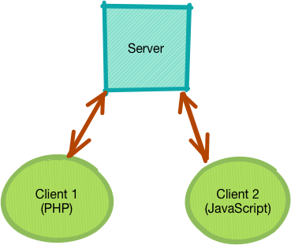
1: Client Server Architecture
REST was modeled on 'web architecture' – which is Client-Server architecture.
This allows for 'Separation of Concerns':
Both client and server have distinct roles to play.
Server provides data.
Client can render the data (say a Browser displaying a webpage in a UI).
Both client and server can be implemented using different technologies and technologies:
For example, the server can be implemented using Python.
The client can be done using PHP or JavaScript.
Notes:
Instructor notes:
Instructor Notes are the same as Participant Notes.
Please present the Participant Notes.
Participant Notes:
We had Client Server applications before. But Web really popularized this architecture.
Web servers provide data to clients (usually browsers).
When a web server provides HTML, the browser renders it on user's computer/phone/tablet.

Slide 44

2: Statelessness
Server is not required to 'remember' client's state to serve request.
Clients must include all contextual information in each request to fulfill the request.
Client may store the state (session ID) and transmit it with the request.
This design allows the server to serve a large number of clients:
Helps with scalability.
Notes:
Instructor notes:
Instructor Notes are the same as Participant Notes.
Please present the Participant Notes.
Participant Notes:
Web browsers store information in 'cookies'.
Cookies were designed to be a reliable mechanism for websites to remember stateful information.
Examples are :
User's login state
Shopping cart id
https://en.wikipedia.org/wiki/HTTP_cookie

Slide 45

3: Cache-ability
When a web server sends out response, it specifies caching controls.
Stateless nature of web requests facilitates caching.
Caching greatly improves performance:
Large assets (like images) can be cached for faster loading.
Caching also reduced the load on web servers and allows greater scalability.
Caching specifies how long a cached asset is valid:
For example, a web page might be cached for up to an hour.
But an image can be cached for a much longer period (few days).
Notes:
Instructor notes:
Instructor Notes are the same as Participant Notes.
Please present the Participant Notes.
Participant Notes:
A web page can have multiple assets.
HTML page content
CSS: for styling the page
JavaScript scripts
Images embedded in a page
Etc.
Each asset typically will have a cache directive. Different assets may have different cache times.
When a browser is requesting a page, it may load certain items (images, css) from local cache on the user's computer.
Caching helps reduce the load web servers.

Slide 46

4: Layered System
In REST design, a network-based intermediary may intercept client-server communication for a specific purpose.
Some applications include:
Load balancing
Security
Caching
Client cannot tell if whoever is intercepting is the server or intermediary.
This property allows us to deploy proxies or gateways.
(See diagram in the next slide)
Notes:
Instructor notes:
Instructor Notes are the same as Participant Notes.
Please present the Participant Notes.
Participant Notes:
Proxies allow an organization to allow internet traffic in a controlled manner.
Proxies can also cache data.
Gateways are designed to route traffic according to some rules.

Slide 47
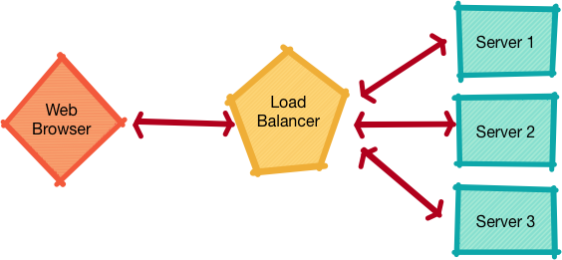
4: Layered System (Cont.)
Notes:
Instructor notes:
Instructor Notes are the same as Participant Notes.
Please present the Participant Notes.
Participant Notes:
Source: Elephant Scale artwork designer.

Slide 48
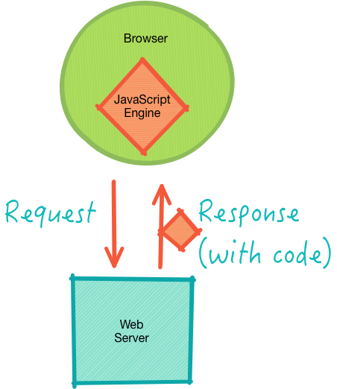
5: Code on Demand
The Web makes heavy use of code-on-demand.
Servers can "push" executable code:
Code runs on the client.
Clients must be able to execute code.
In case of the Web servers:
Servers push JavaScript to the browser.
Browsers execute the code.
Notes:
Instructor notes:
Instructor Notes are the same as Participant Notes.
Please present the Participant Notes.
Participant Notes:
Executing client-side code reduces the load on the server.
For example, JavaScript can do animations and rendering in the browser.
Rendering graphs in a browser is a pretty good example of this.
Checkout D3 library (https://d3js.org/)

Slide 49

6: Uniform Interface
The interactions between the Web’s components—meaning its clients, servers, and network-based intermediaries—depend on the uniformity of their interfaces.
Web components interoperate consistently within the uniform interface’s four constraints, which Fielding identified as:
Resources Identified in requests (URI)
Resource Manipulated through Representation
Self-Describing Messages
Hypermedia as the engine of Application State (HATEOAS)
Notes:
Instructor notes:
Instructor Notes are the same as Participant Notes.
Please present the Participant Notes.
Participant Notes:
The uniformity of the interface is what gives REST the capability to be used and integrated by many clients. The rest architectural pattern is flexible and reusable across many domains, and once understood, can be used almost anywhere.

Slide 50
What is HATEOAS?
HATEOAS = Hypermedia As The Engine Of Application State.
Hypermedia is a document-centric approach with the added support for embedding links to other services.
One of the uses of hypermedia and hyperlinks is composing complex sets of information from disparate sources.
<podcast id="111">
<customer>http://customers.myintranet.com/customers/1</customers>
<link>http://podcast.com/myfirstpodcast.mp3</link>
<description> This is my first podcast </description>
</podcast>
Notes:
Instructor Notes:
Go through the code on the screen, illustrate what each line means.
Participant Notes:

Slide 51
Rest Lab
In this exercise, we will design a simple REST service.
We will build a service.
And use the browser to access the service.
Please refer to lab notes for detailed instructions.
Notes:
Instructor Notes:
Participant Notes:

